Slide 1
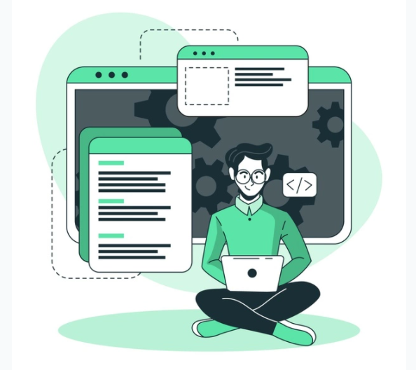
SOFTWARE DEVELOPMENT LIFE CYCLE
AUTHOR: Karmele Elorza

Slide 2
1
SDLC (SOFTWARE DEVELOPMENT LIFE CYCLE)

Slide 3
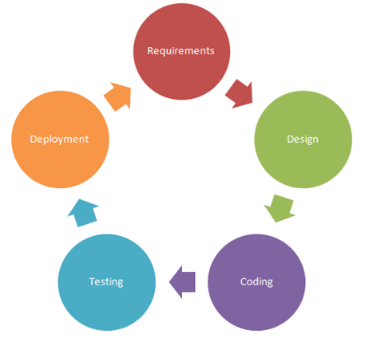
What is SDLC?
SDLC means Software Development Life Cycle and is used to design, develop and produce software products in the software industry.
Developing a software product isn´t ass easy ass coding, so it has some phases that consist in doing more effective the process of creating the product.

Slide 4
2
PHASES OF SDLC

Slide 5
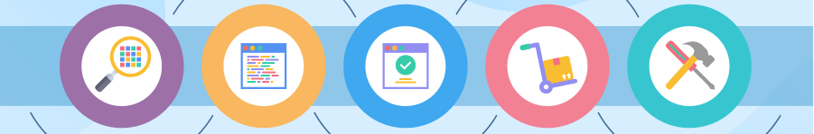
What are the SDLC phases?
1. Planning and Define Requirements
3. Development
5. Maintenance
2. Designing
4. Testing

Slide 6
2.1
PHASES OF SDLC: PLANNING and DEFINE REQUIREMENTS

Slide 7
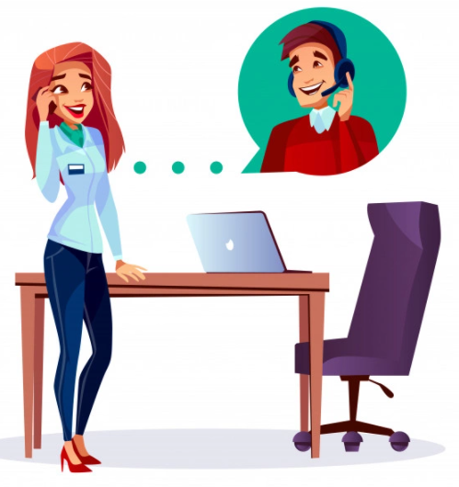
Planning and Define Requirements
Planning is a very important phase because it has to contain the purpose and all the problem that have to be solved with one or some meetings with the customer.
Define requirements are conditions for designing and developing the product that customers set.

Slide 8
2.2
PHASES OF SDLC: DESIGNING

Slide 9

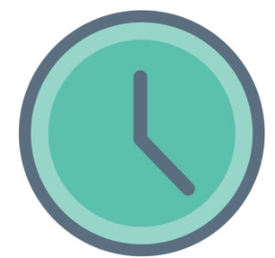
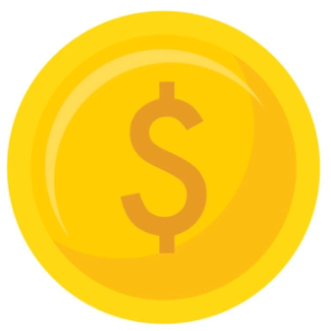
Designing
Designing is a very important phase because it has to contain important parts ass the purpouse of the product, the define requirements, the time cost, the prize, the risks, the programming language that will be used...

Slide 10
2.3
PHASES OF SDLC: DEVELOPMENT

Slide 11
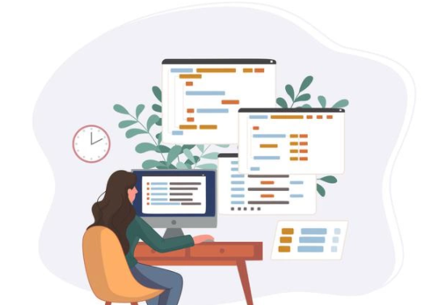
Development
Development phase is where the coding starts.
When all the planning and designing is done, the next step is this phase that the programer tells the machine the orders it has to execute.

Slide 12
2.4
PHASES OF SDLC: TESTING

Slide 13
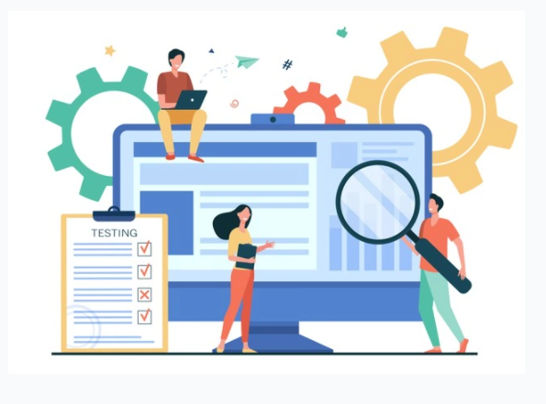
Testing
Testing is where the product is tested to see whether it contains the necesary requirements and works well or are bugs to fix.
On this phase customer see the final product and it verify that the requirements are done properly. If the customers verify the requirements of the product, is called acceptance testing.

Slide 14
2.5
PHASES OF SDLC: MAINTENANCE

Slide 15
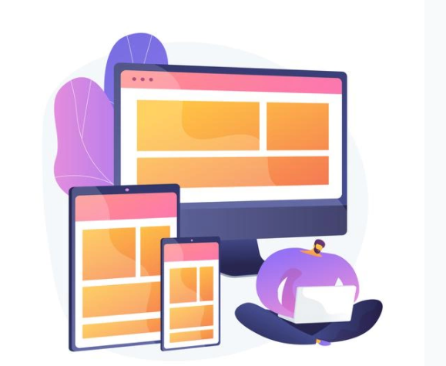
Maintenance
Maintenance is where the final product is given to the customer and is checked that can support changes. If not, it will have to be changed to support those changes of the customer.

Slide 16
3
SDLC MODELS

Slide 17
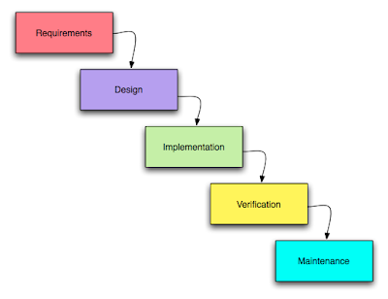
Waterfall model
Waterfall model says that to start a new phase, it is necesary to end with the old one. And if you want to go to an old phase, you have to go through the phases again.
This model is used when the requirements are stable and very clear or when we know it is going to success.
This model has some advantages and disavantages ass : it´s easy to design, the quality is high and also it needs less qualified staff. But on the other hand, the requirements has to be set on the beginning so it´s difficult to go to old phases and also we don´t have the product until the end.
For example the way from verifications to desing: Verification – Design - Implementation - Verification – Maintenance.

Slide 18
Evolution model
Evolution model says that we will give better and better version of the product until the final product, so we will have to go through all the phases in each version.
This model is used when the requirements are not stable and will be many changes.
This model has some advantages and disavantages ass : it´s easy to show the evolution to the customer to receive a feedback. But on the other hand, it is difficult to plan the prize and the time that will cost the product.
First version
Second version

Slide 19
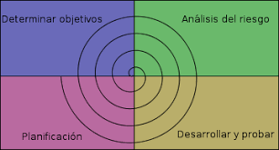
Spiral model
Spiral model has 4 phase and we have to go through all when something new is added.
This model is used when the risks are very high and it will be many changes.
This model has some advantages and disavantages ass : risks are always analysed, we can start working from the first day and the quality is quite high. But on the other hand, it isn´t easy to evaluate the risks and the prize and time cost can be high (based on how many times we go through the 4 phases).
Determine objectives
Risk analysis
Planning
Develop and test

Slide 20
SOFTWARE DEVELOPMENT LIFE CYCLE

